Slide 1
Hippocampal Replay
April 13, 2021
Giacomo Marino, Matt Salomon, Estelle Han, Rebecca Li

Slide 2
Guiding Questions
In everyday activities, animals have the ability to plan and make decisions based on future potential rewards as well as prior experiences → Evaluation
How does evaluation of experiences inform decision-making?
Which experiences are considered or ignored during deliberation?
How can we model this phenomenon in a computational RL model?

Slide 3
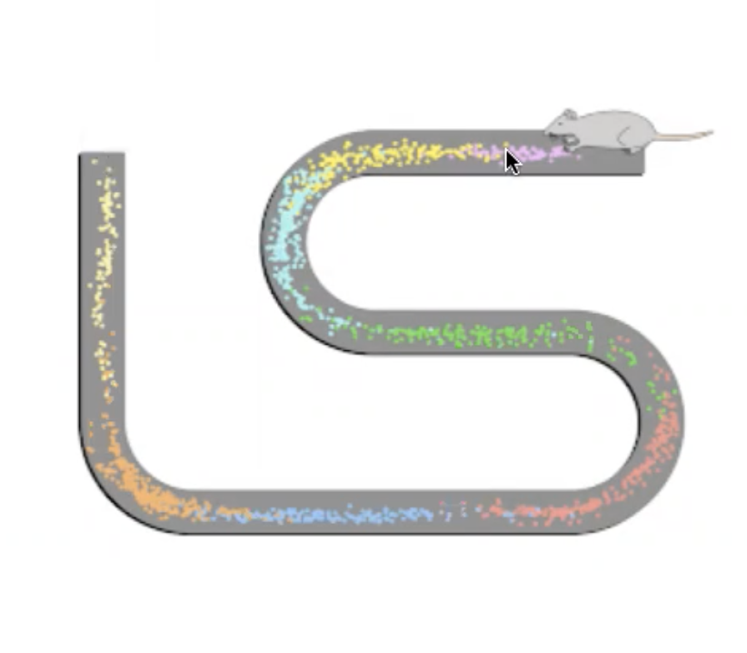
Place Cells and SWRs
In spatial navigation, hippocampal place cells represent an animal’s spatial position, as well as representing locations ahead of or behind the animal during movement pauses (Mattar and Daw, 2018)
When sharp-wave ripple (SWR) events coincide with sequences of hippocampal place cell activity, this is referred to as ‘replay’
Believed to be an underlying mechanism for planning through depicting spatial trajectories to reward locations
Forward replay and reverse (backwards) replay
Suggested to be involved in planning, memory retrieval, consolidation, and the creation/maintenance of a cognitive map (Mattar and Daw, 2018)
Reward revaluation causes rate remapping of hippocampal place cells

Slide 4
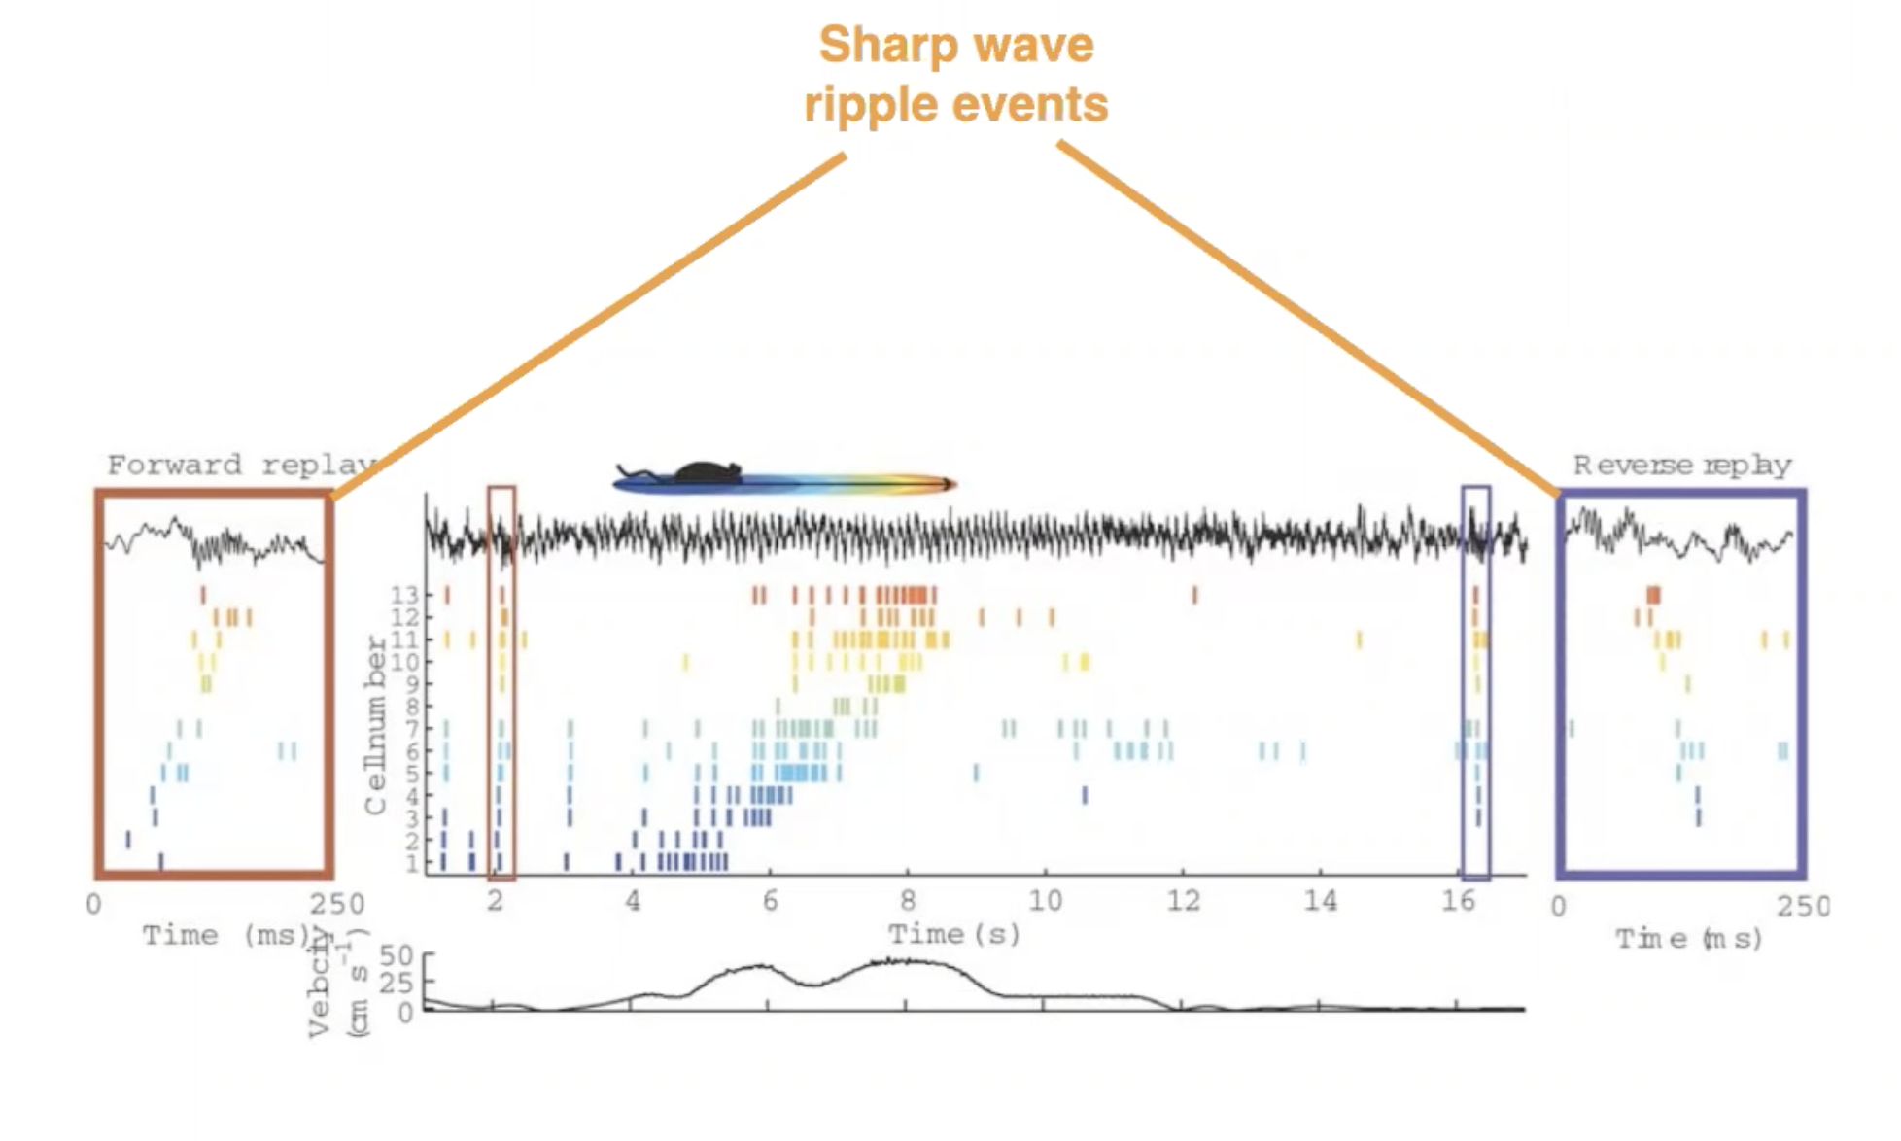

Slide 5
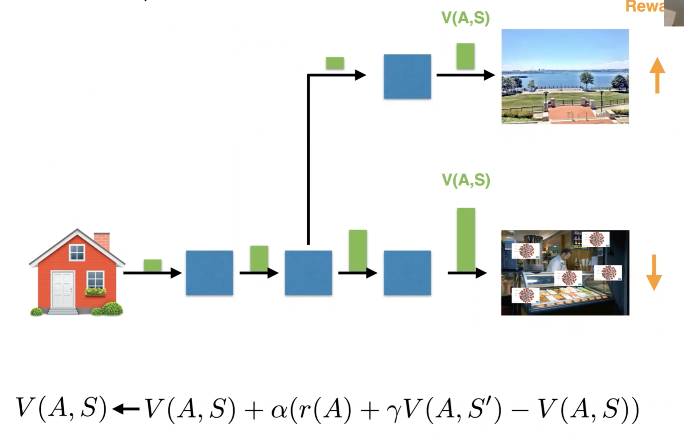
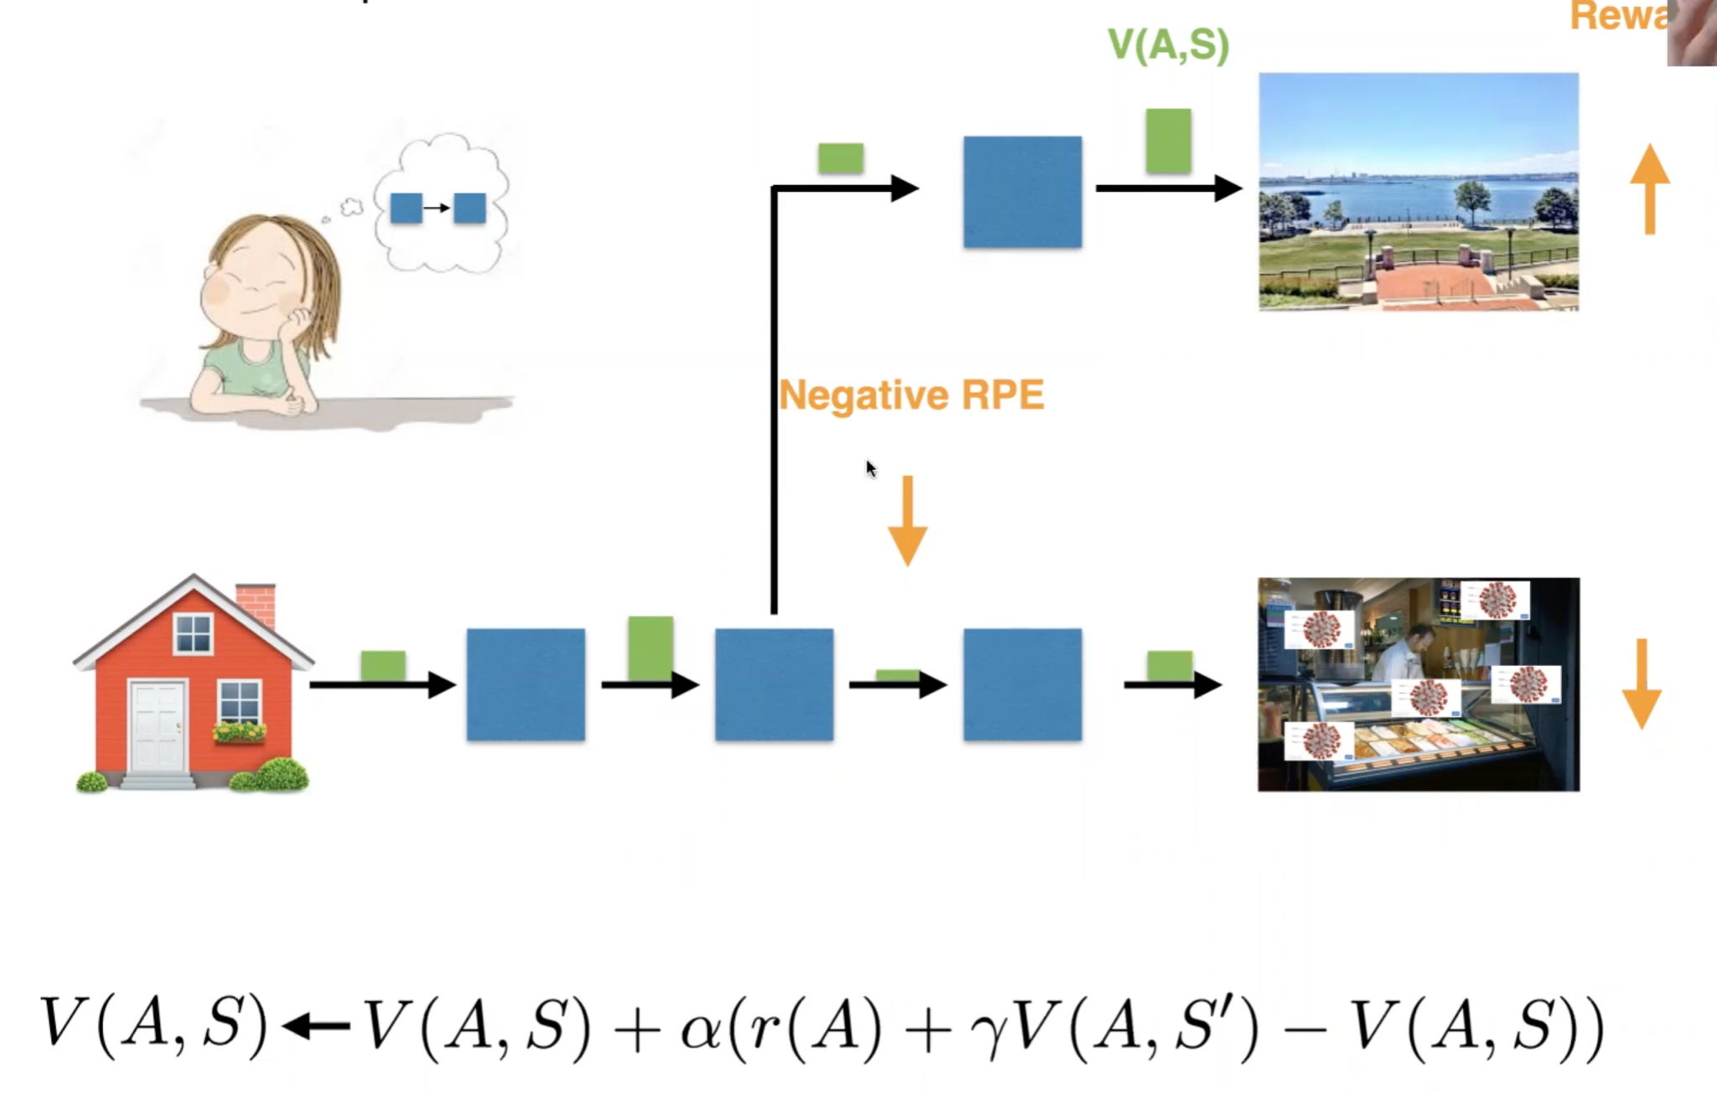
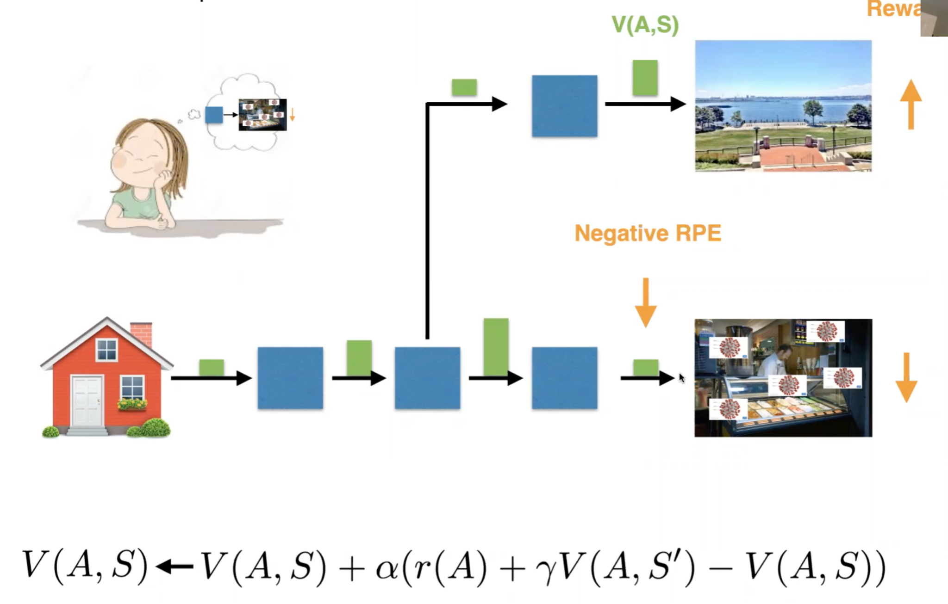
Simulating Experience
** trained pre-COVID-19
Issues:
Model-Free - Don’t want to have to experience something bad to know its bad
Prospective Planning - Computationally expensive

Slide 6
Trajectory Sampling vs Prioritized Sweeping
Trajectory Sampling - simulates individual trajectories and performs backups at the state or state–action pairs encountered along the way
Correlate with forward replay
Seen in prospective planning, sampling states that the agent is likely to be in after future actions.
Prioritized Sweeping - Maintains a queue of each state-action pair whose estimated value would change nontrivially if backed up (largest RPE)
Correlate to backwards replay
Seen in COVID ice cream example, simulating from each state-action pair starting with the terminal state
(Sutton and Barto, 2015)

Slide 7
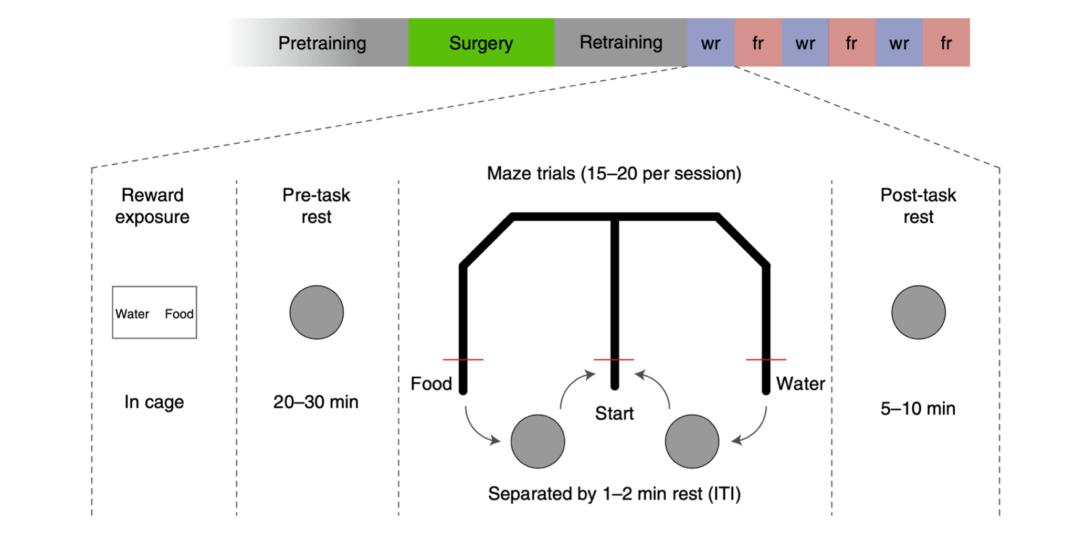
Carey et al. 2019
Trained 4 rats to run around T-maze looking for food and water.
Before daily recording sessions, the rats were alternately food or water-restricted
Caused them to revalue the food and water outcomes due to a shift in their motivational state
Recorded neural ensembles from the dorsal CA1 area of the hippocampus
** Food and water did not vary significantly in reward value

Slide 8
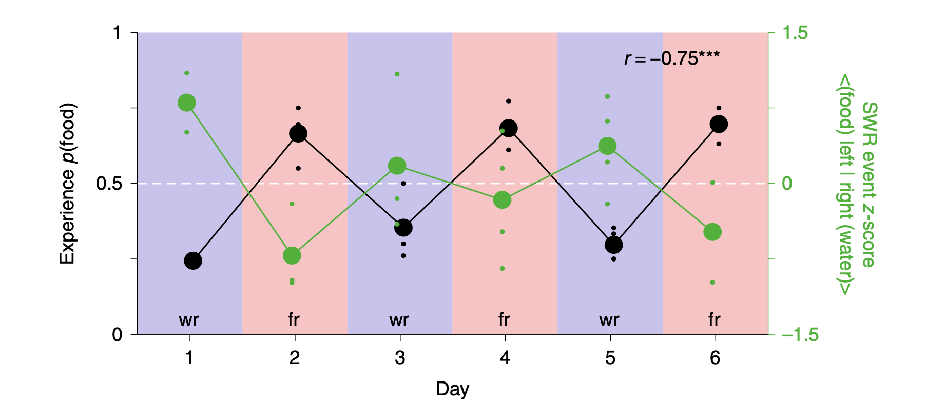
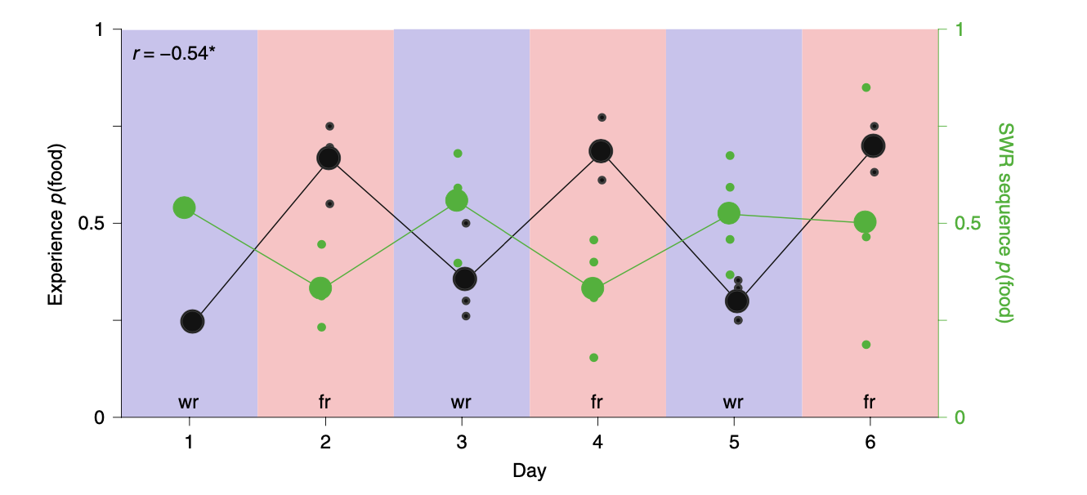
Experience and Simulation
Sharp wave ripple events are indicative of replay activity
Simulation of the opposite-than-restricted path
E.g. If food-restricted, the rat will simulate the path to the water, devalue that path, and then experience going to the food

Slide 9
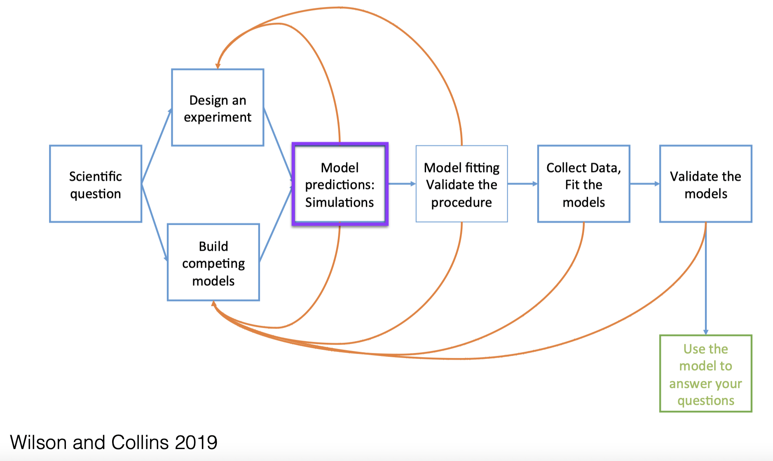
Specific Goals
The experiment and task are laid out in Carey et al, 2019.
The goal is simulate the task and compare efficiency and speed of learning with different parameters and types of replay when one rewards value changes.

Slide 10
Specific Goals
Simulate the data pertaining to the study with four different conditions and observe the effects on the speed of learning.
Compare our simulated data to the results of the Carey et. al 2019 paper and assess, whether or not with our model, that replay of the devalued path increases learning efficiency in case where rewards are revalued.
Assess if backwards replay is more effective in revaluing the appropriate paths than forward replay.

Slide 11
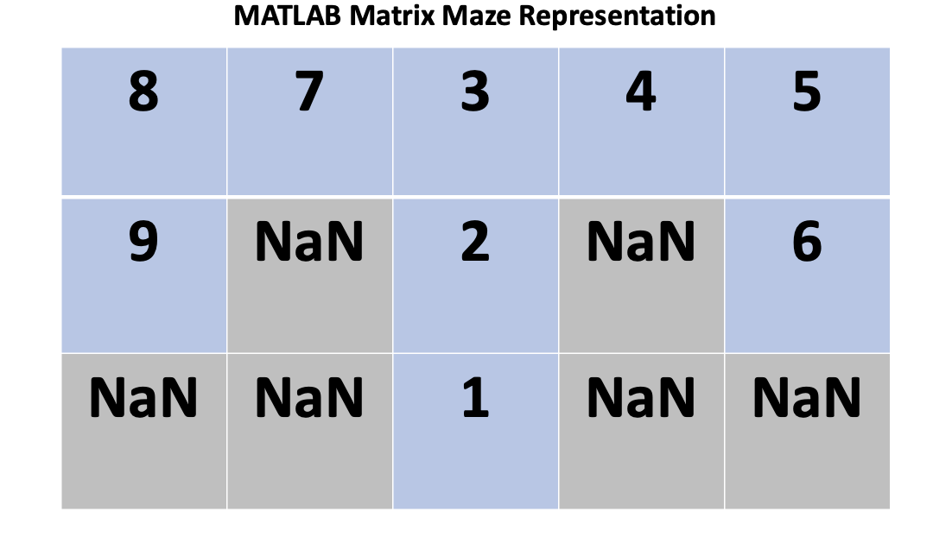
The Task Setup and Design
The maze is a collection of 9 states.
The food reward is positioned at state 9 and the water reward is positioned at state 6.
If the agent reaches one of the terminal states (6 or 9), the trial ends and the agents begins again at state 1.

Slide 12
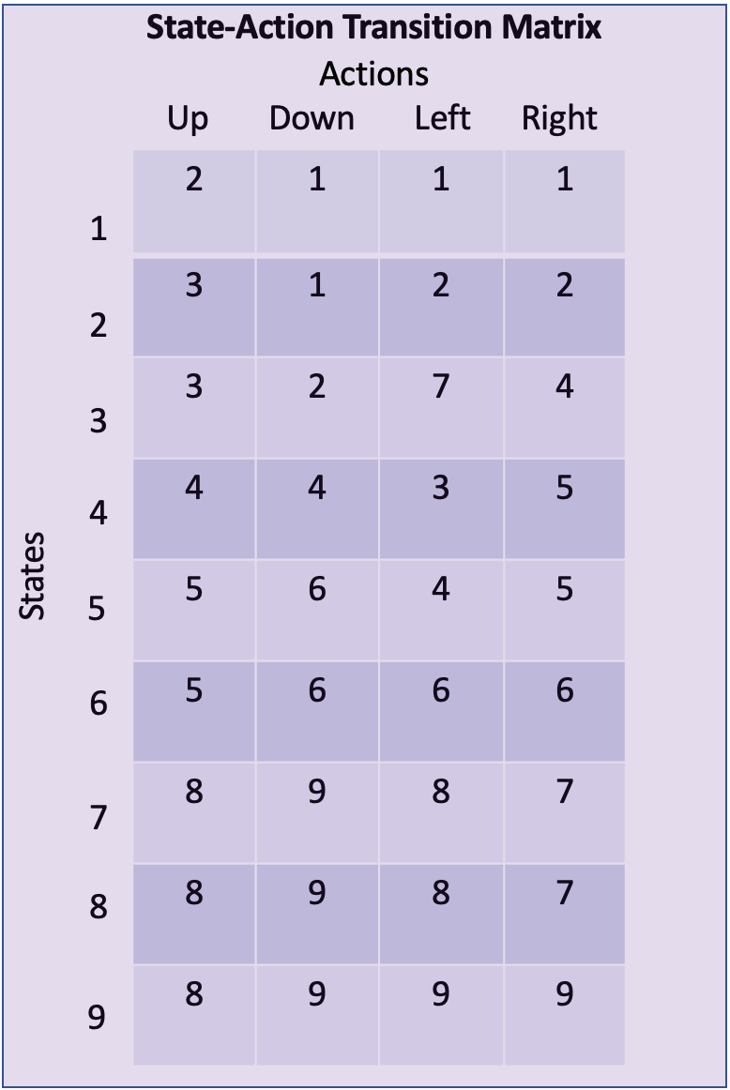
The Task Setup and Design
Each row corresponds to state and each column corresponds to the next state given the action of the column.
A corresponding values matrix for the q-value of each move is also represented in the same fashion.
The rewards are in a vector and during training carry an equal value.

Slide 13
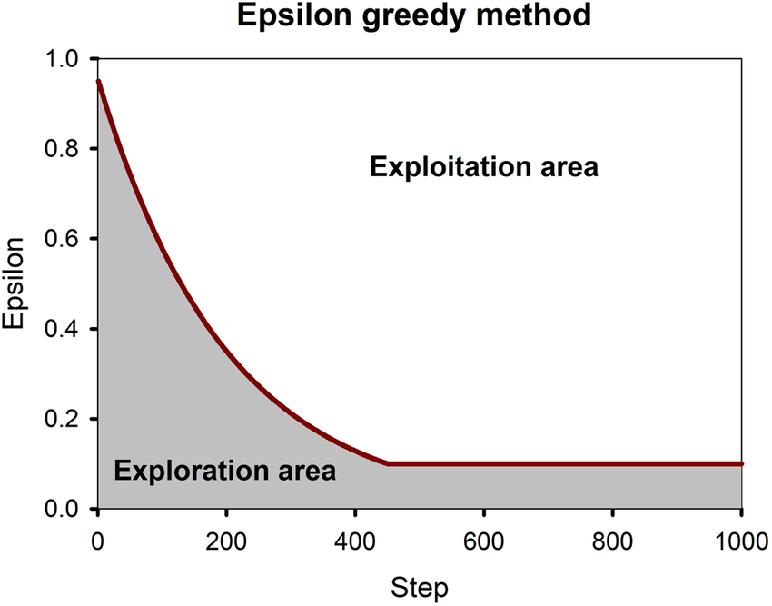
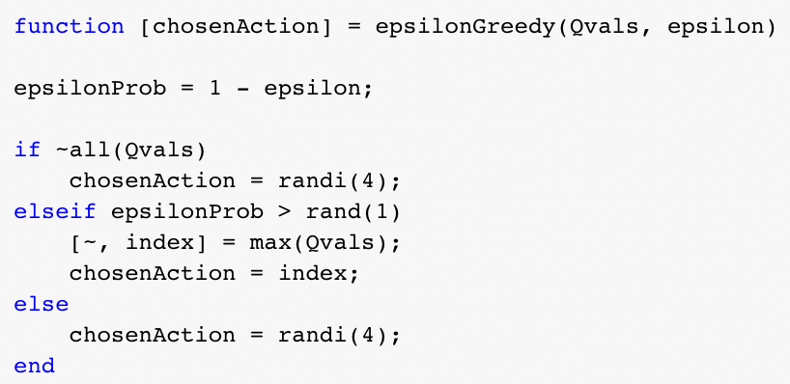
Task Setup and Design
Epsilon Greedy
Function to decide which action is chosen
If the values of the current state are all zero or if 1 - epsilon is less than a random number between 0 and 1, a random action is chosen.

Slide 14
Task Setup and Design
Evaluating learning speeds of the models:
Switch value rewards from equal weights in training to increase value in a food or water-restricted state.
Then we evaluate how many trials it takes for the agent to correctly value the newly more rewarding path.
We compare both forward and backward replay, as well as favoring the more valued or less valued path during replay

Slide 15
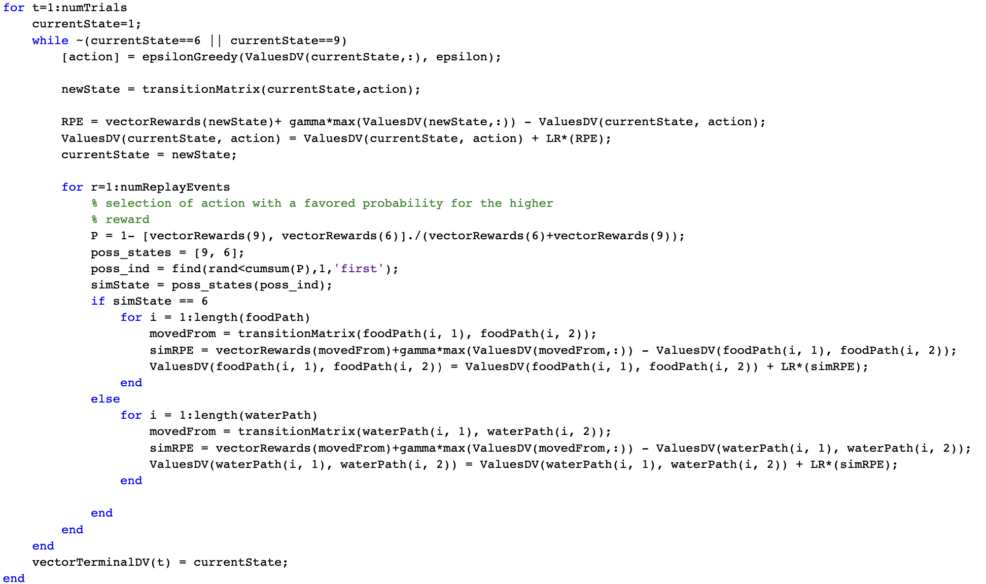
Task Setup and Design
Each trial operates from a while loop wherein the agent moves from state to state, revaluing each state action pair and performing replay at each step.

Slide 16
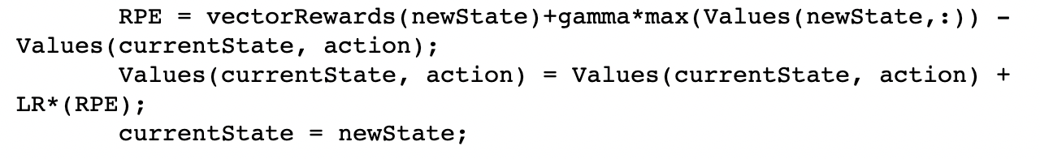
Task Setup and Design
Valuing States and Parameters:
alpha: learning rate which was tested with values of 0.1 and 0.01.
gamma: discount factor for proceeding states which was tested with values of 0.6 and 0.8.

Slide 17
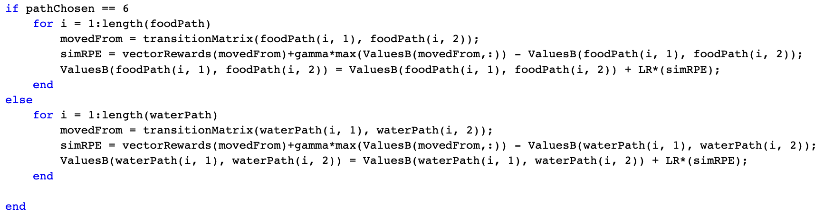
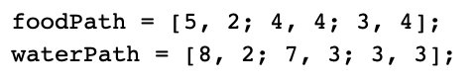
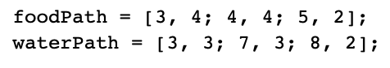
Modeling Hippocampal Replay
In between each move, the agent can ‘replay’ a certain path as they have a knowledge of the maze.
The agent is tested in by its learning speed from both forward replay
Starting from the current state and continuing to a reward
And backward replay
Starting from one reward and moving backward to state 3
The agent follows paths that are defined toward the reward and backward from the reward.

Slide 18
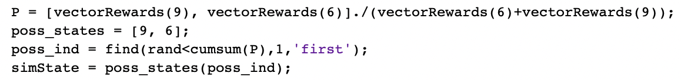
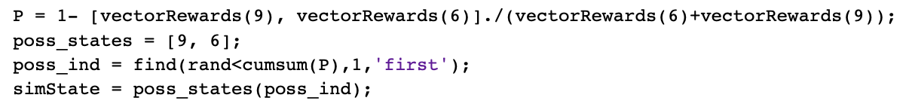
Modeling Hippocampal Replay
Since the agent has learned the maze and valued each state, we assume that it knows the rewards at each terminal state.
A set replay events are used each step the agent takes
In the top version, the replay moves forward to the reward.
The P value can be changed to value the devalued reward or the opposite by subtracting its value by 1
Favoring valued vs devalued path

Slide 19
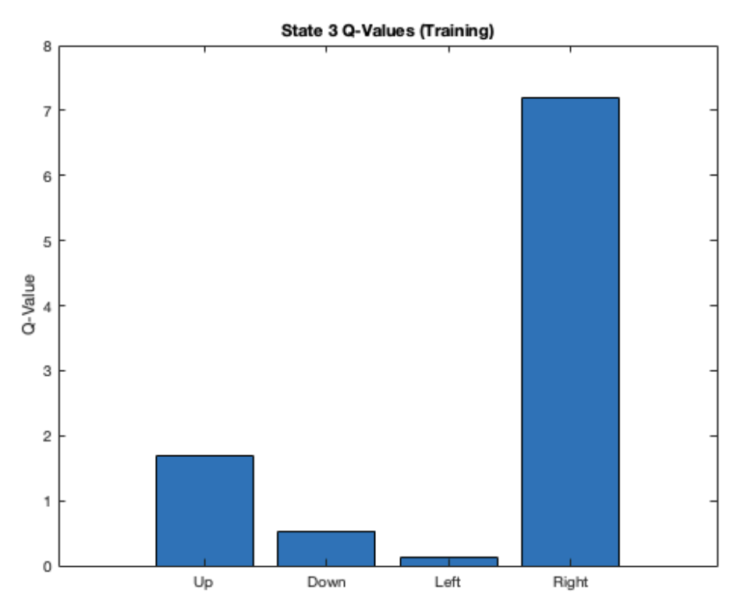
Results - Training
Ran 100 trials such that the value of food was 20 and the value of water was 10
Representing a food-restricted state

Slide 20
Results - Varying Parameters
Varied learning rate from 0.1 & 0.01, epsilon from 0.1 & 0.3, and gamma from 0.6 & 0.8
Averaged over a 100 simulations each for the data plots
For each simulation, ran 80 trials with 3 replay events each
For the revaluation, switched the values of food and water such that the value of food was 10 and the value of water was 20
Representing a water-restricted state

Slide 21
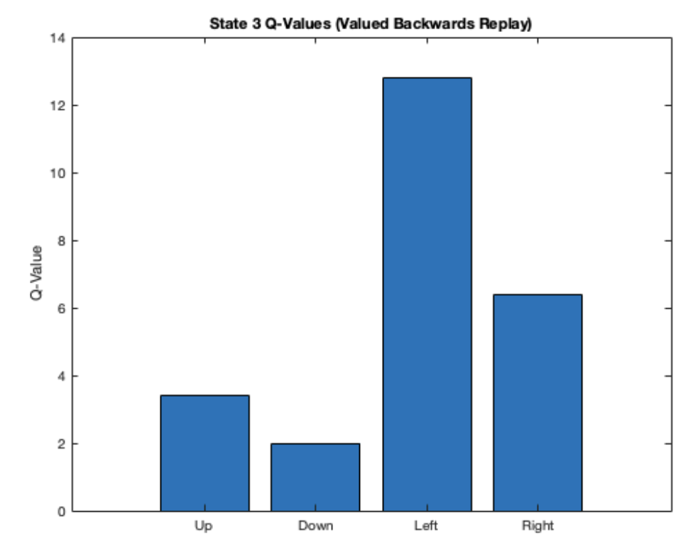
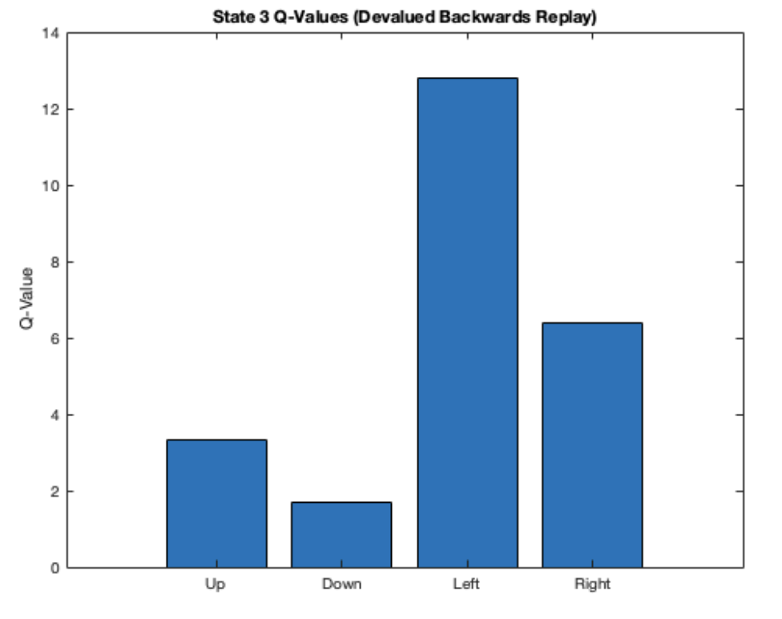
Results - LR = 0.1, epsilon = 0.1, gamma = 0.8

Slide 22
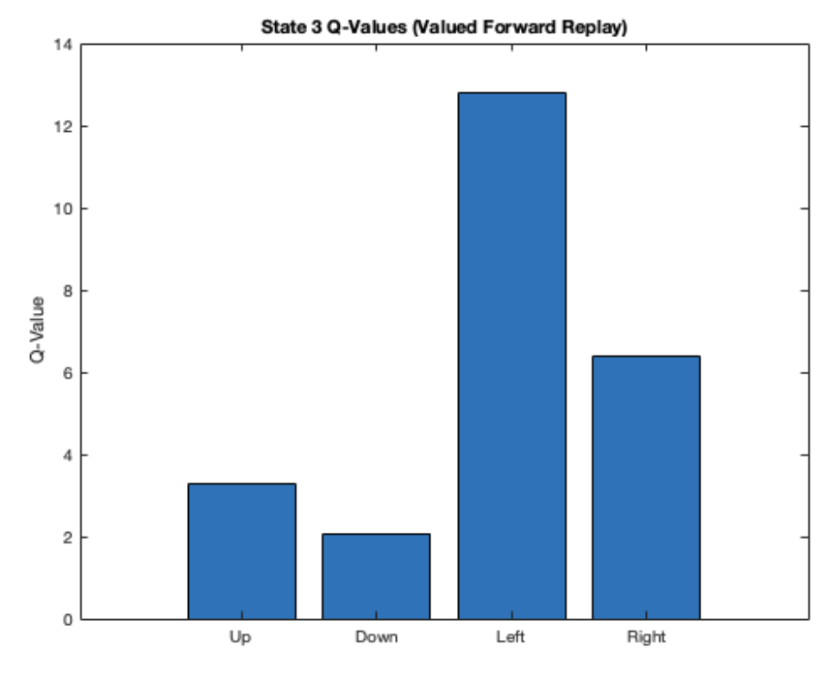
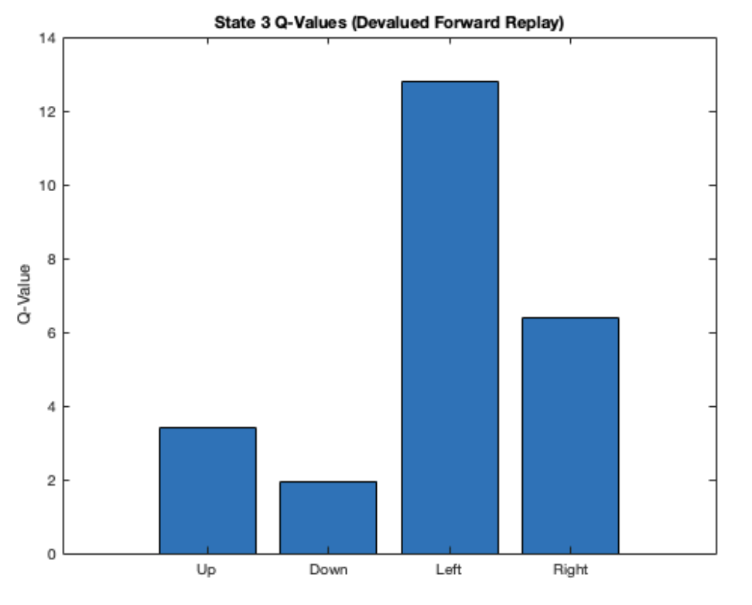
Results - LR = 0.1, epsilon = 0.1, gamma = 0.8

Slide 23
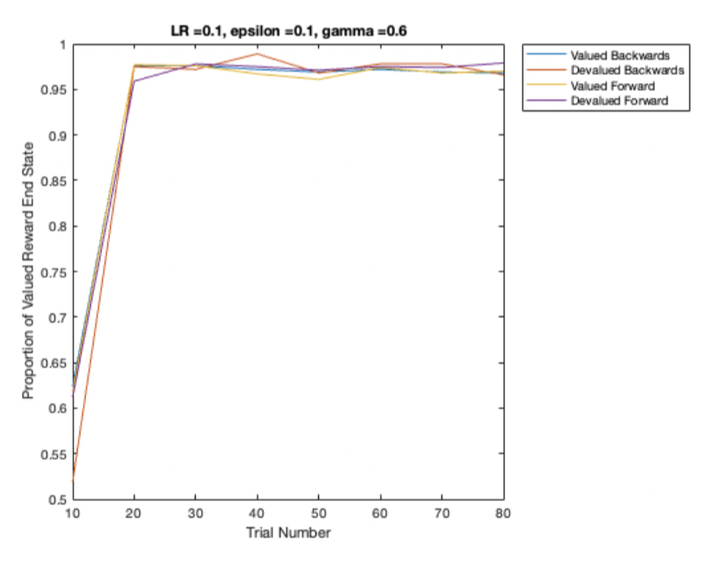
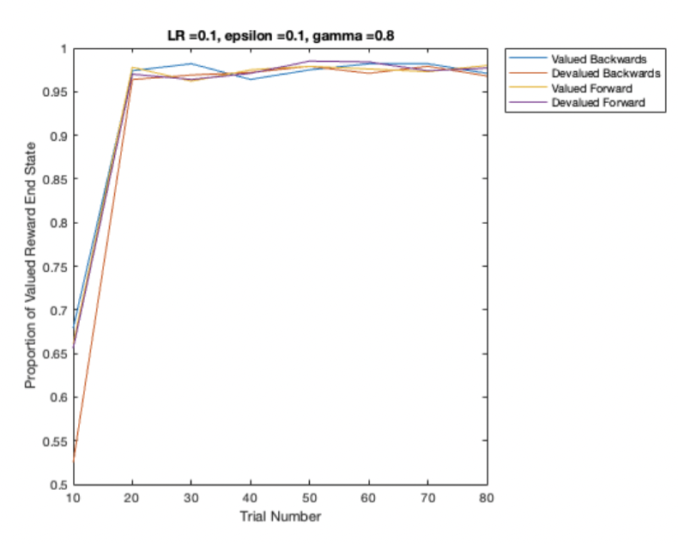
Results - Varying Parameters
Notes:
Gamma does not really affect it

Slide 24
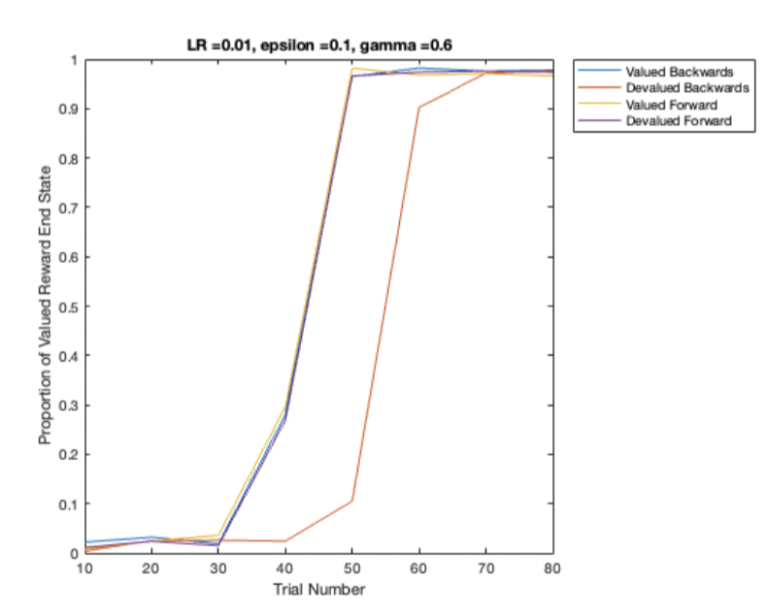
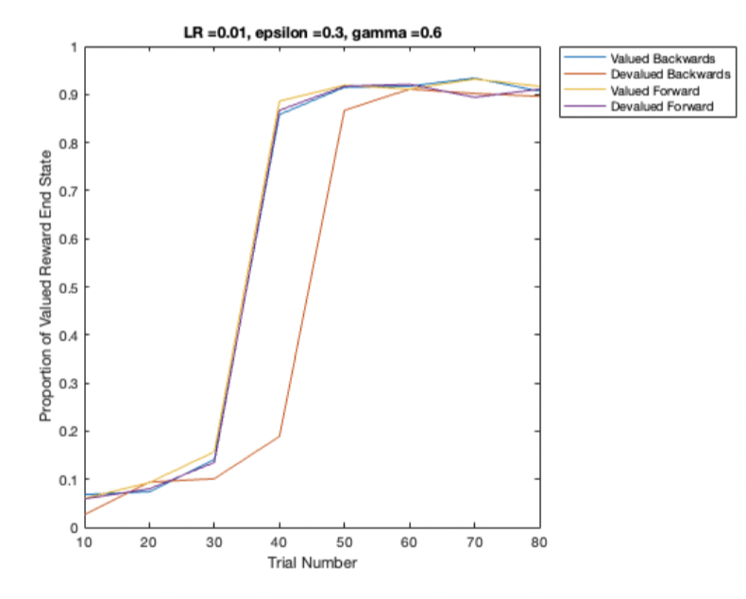
Results - Varying Parameters
Notes:
Epsilon does not really affect it

Slide 25
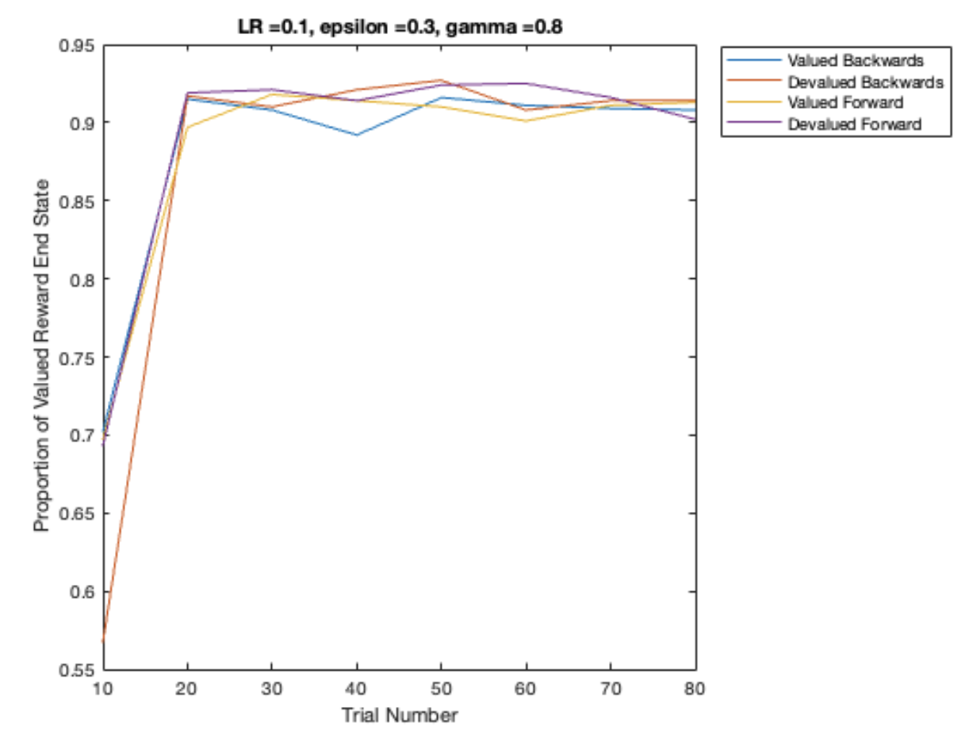
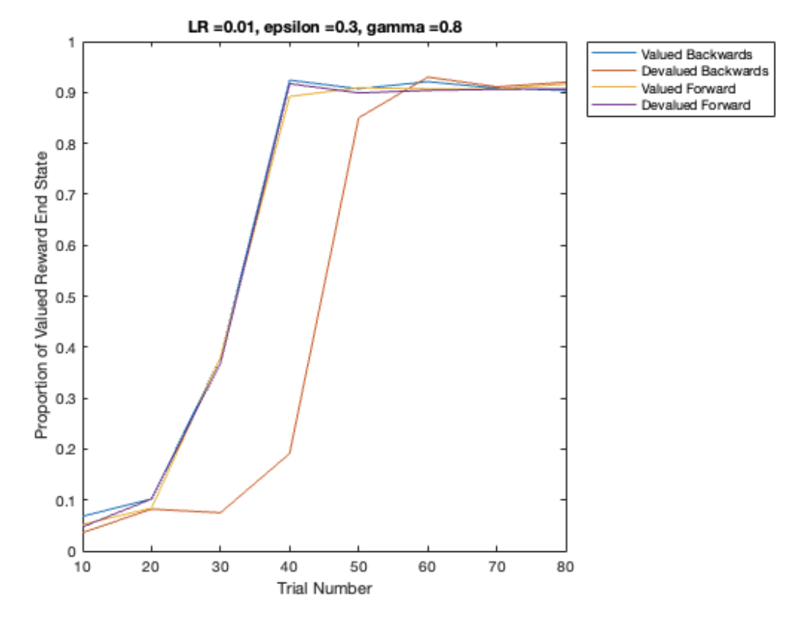
Results - Varying Parameters
Notes:
Lower LR makes devalued backwards worse

Slide 26
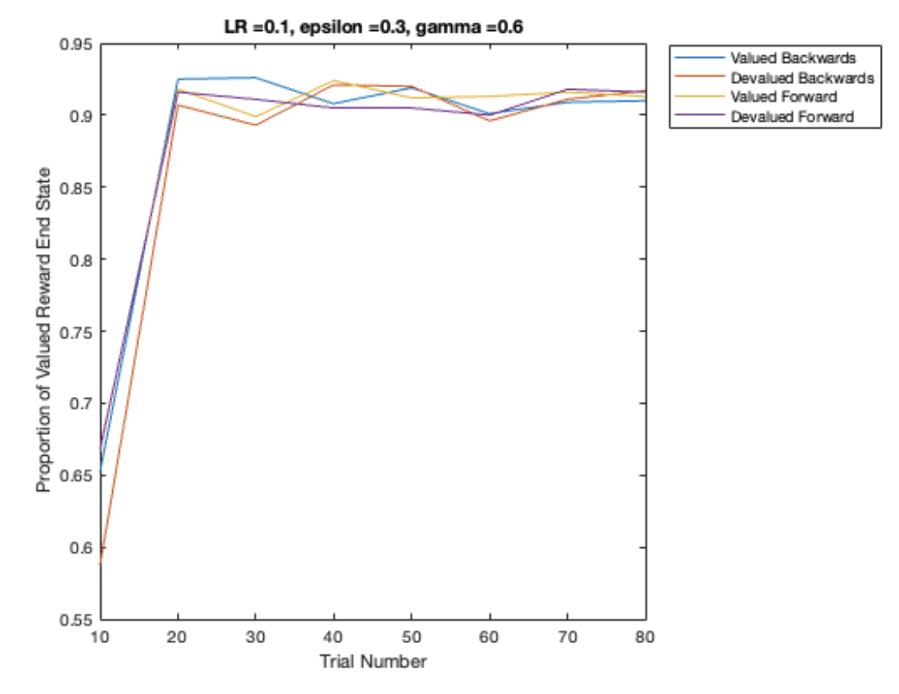
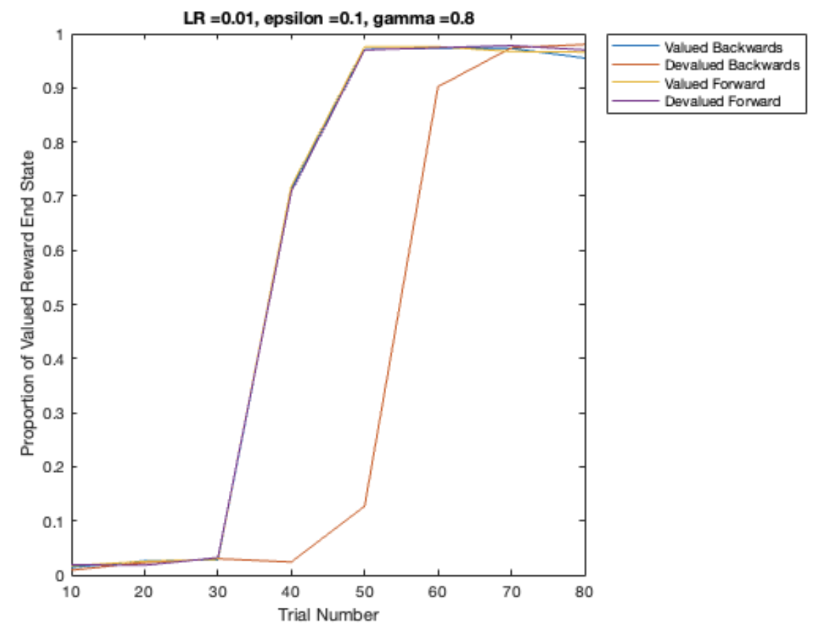
Results - Varying Parameters
Notes:
Does not seem to be really affected that much with changes in epsilon and gamma

Slide 27
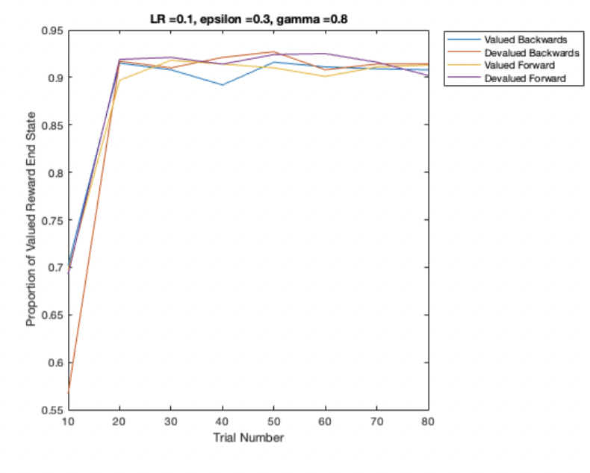
Discussion: devalued backwards
Notes:
Devalued backwards learns the slowest (most # of trials to reach certain proportion of valued reward end state).
Difference between all other replays are marginal.
This is contradictory to our hypothesis! predicted that backwards replay would result in faster learning than forwards replay
--expected backwards replay to be more efficient because changing value of the reward will affect the value of the closest state to the end, and this will update the value of the next closest state
(backward replay can propagate the value back to preceding states)
&We predicted that replay of devalued path would result in faster learning than replay of valued path
--expected replay of devalued path to be more efficient because the paper whose task we are modeling (Carey paper) demonstrated hippocampal replay preference towards the devalued outcome
Also interesting how it’s not a graded effect -- devalued forward and valued backwards are comparable to the learning speed of valued forward

Slide 28
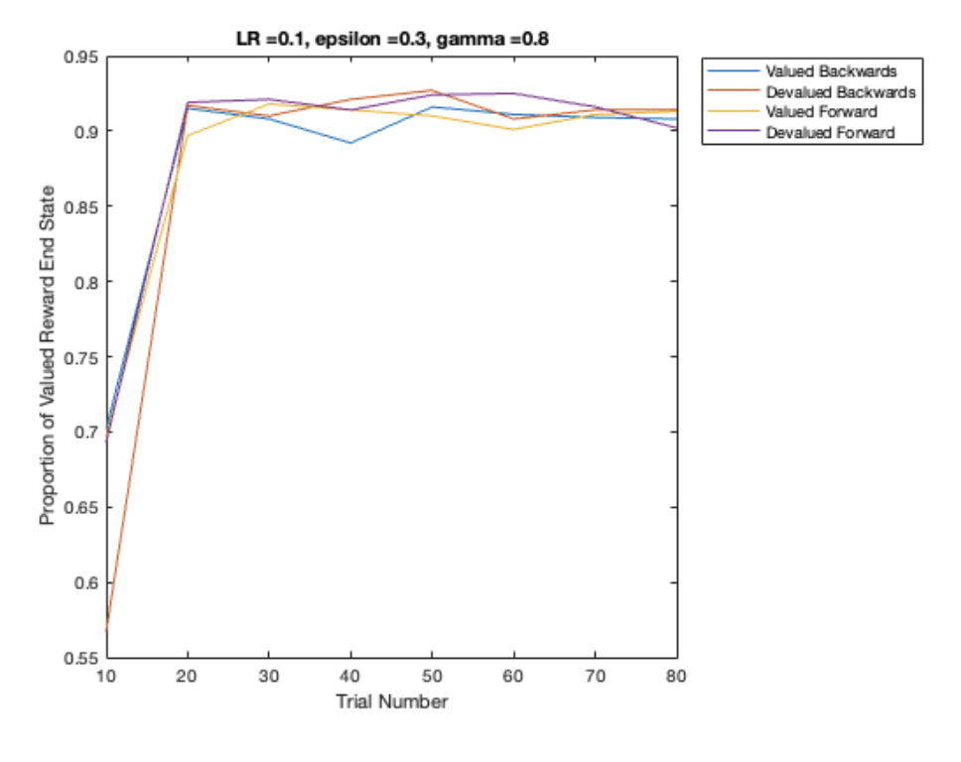
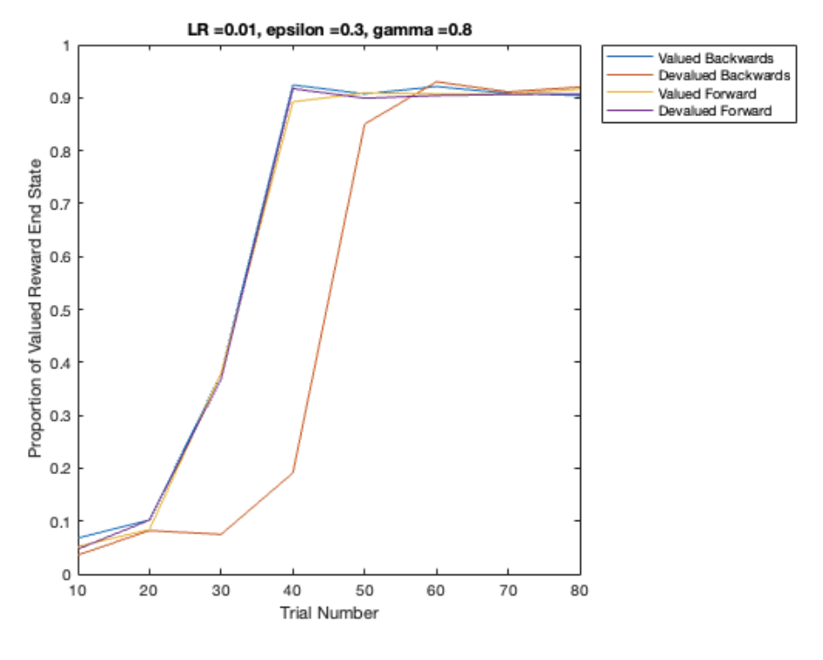
Altering Parameters: Changing LR
Notes:
When LR decreases, most negatively affects devalued backwards -- the difference in learning rate between devalued backwards and the other replays increases!
Lowering learning rate makes it slow for everything -- self-explanatory

Slide 29
Discussion
Research Question 1: Does replay of the devalued path increase learning efficiency?
(DV: how many trials until it learns to devalue one option?)
Research Question 2: Is backwards replay is more effective in revaluing the appropriate the paths than forward replay?
Result: Devalued backwards replay results in slowest learning rate
Notes:
-in all cases, agent learns to revalue eventually
-research question is, can we increase learning speed by including model/replay and altering the order of replay (backwards vs. forwards), and altering the location of replay (valued vs. devalued path)
these results suggest that our model does not show what we expect ---Carey paper demonstrated hippocampal replay
preference towards the unrestricted/devalued outcome
We also expect backwards replay to increase learning more than forwards replay
the larger scientific question of interest: how is memory/spatial navigation modeled in the the brain and how can we model it using computational models?
-computational model needs to be altered
-perhaps our model is missing a component or variable. We’d expect that replay of devalued path increases learning speed more because we would replay path that’s not taken (simulating experience)

Slide 30
Future Directions
In order to validate results, we could
-Optimize parameters w/o devalued backwards
-More complex space
-Use softmax instead of epsilon greedy
-Currently, in between each move, the agent can replay. Instead, we can prioritize replay
-instead of hardcoding replay path, can create probability
Notes:
-current replay is hard coded
-include function/parameter to decide which way to go in replay

Slide 31
Future Directions: interesting
Replay in non-successive order (if transition structure changes)
Widening width of paths: prioritize replay of salient experiences (direct path) rather than all possible paths to the reward
Successor representation: v
Notes:
Successor representation: Unlike one-step transition matrices that are known as models in model-based RL, the successor matrix can reflect non-adjacent dependencies. This allows the agent to understand relationships between a state and multiple successor states, knowledge which can be used to solve inference problems, such as finding the shortest path to a new reward location
-increasing complexity of maze, we can use successor representation to find shortest path to reward location

